Slide 1
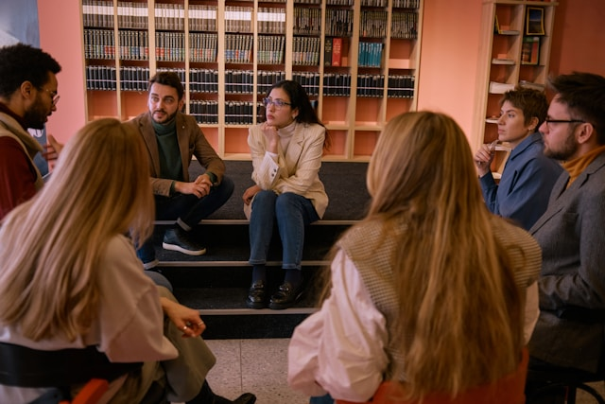
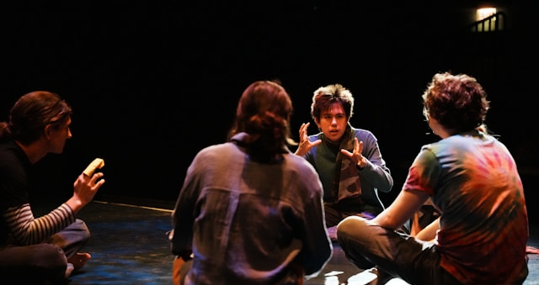
Word Made Flesh
Using the creative process - imagination, emotion, creativity and action - to experience the power of the biblical text
Preaching, bible study, reading scholars’ commentaries, and personal contemplation are all well-established ways of exploring and bringing understanding to a biblical text. Preaching can harness emotion and prophetic power; its reception is often passive and individual even in a crowd. Bible study can be a corporate experience often emphasising rational engagement. Reading scholars brings both broad and deep insight and is done individually without interaction. An Ignatian approach invites the individual to enter the text using their own imagination allowing the process of such vivid and intense contemplation to shine a light on its truth and meaning.
By having actors explore the text in rehearsal, using the expertise of scholars, the audience’s understanding, as well as the actors’ own experience, the text can come alive in fresh ways. Interpretations
and theology are interrogated in the rehearsal process, so that
the prophetic power of the story can be experienced, as well
as various scholarly approaches learned and understood,
Word Made Flesh is a process of reflection, learning and worship that is an immersive experience as much as it is a way of teaching the bible

Slide 2
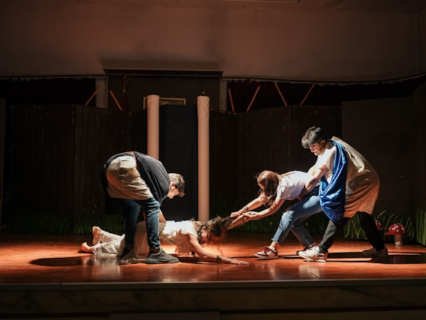
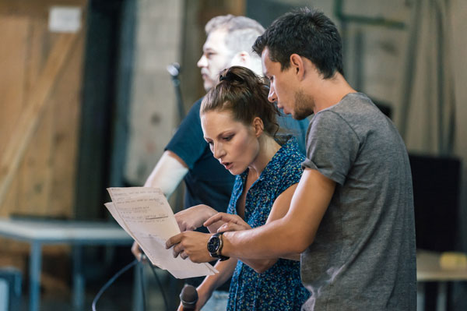
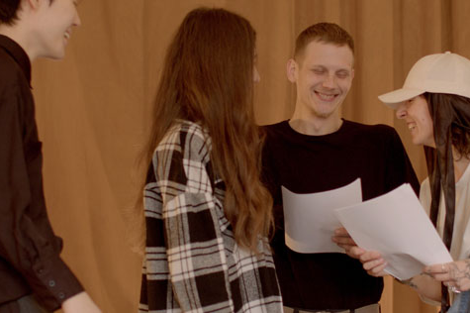
Word made Flesh
How does it work?
A text is chosen and then rehearsed in front of an audience.
The actors are influenced in their choices in many ways: the prescriptions and intrigues of the text; the insights of scholars; the observations of the audience; and the emotional and rational impulses they themselves experience.
Interpretations and assumptions we have of the bible story are tested by bringing them to life in the rehearsal process. Discoveries are made through the dynamics of the actors’ interaction, and the impact of words, actions and other creative expression such as music, poetry and art. The process is interactive and participative. It may naturally incorporate prayer and worship, with moments of discussion or personal reflection.
The process aims to honour what is already understood and appreciated in a text, and also to learn from other insights and opinions. The intention is to experience afresh the extraordinary power and skill in the gospel writers’ craft, the complex reality of being human, and the grace and truth of Jesus.

Slide 3
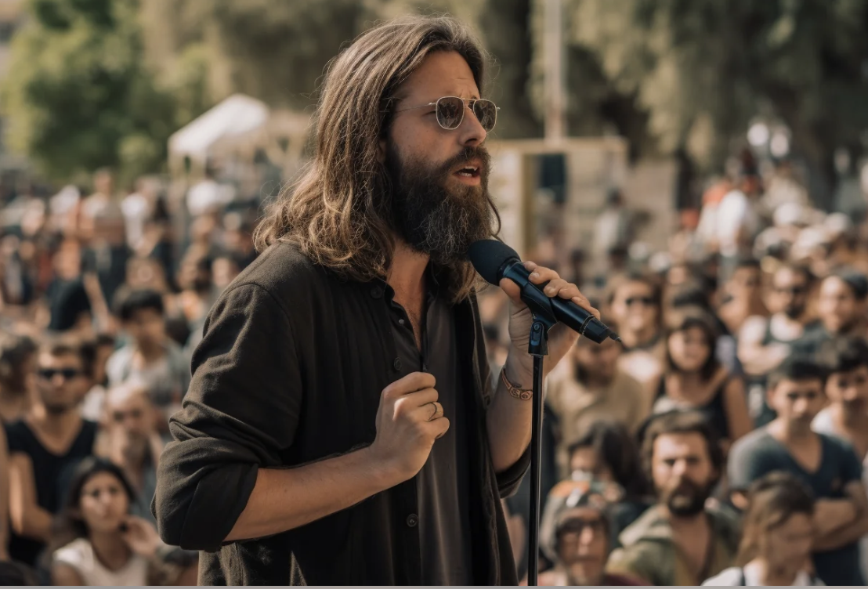
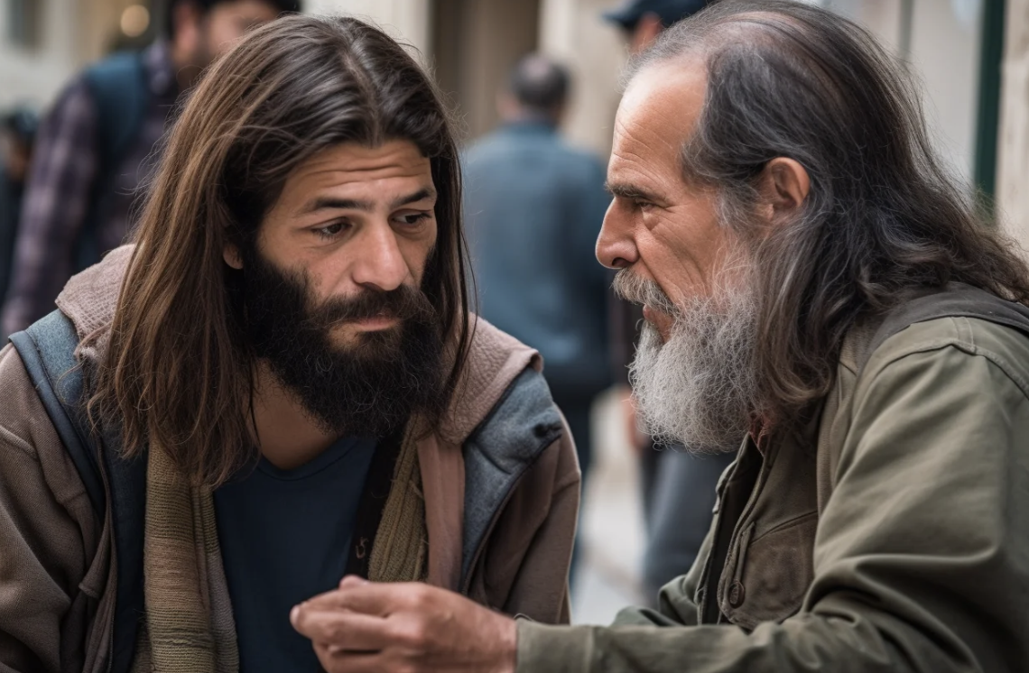
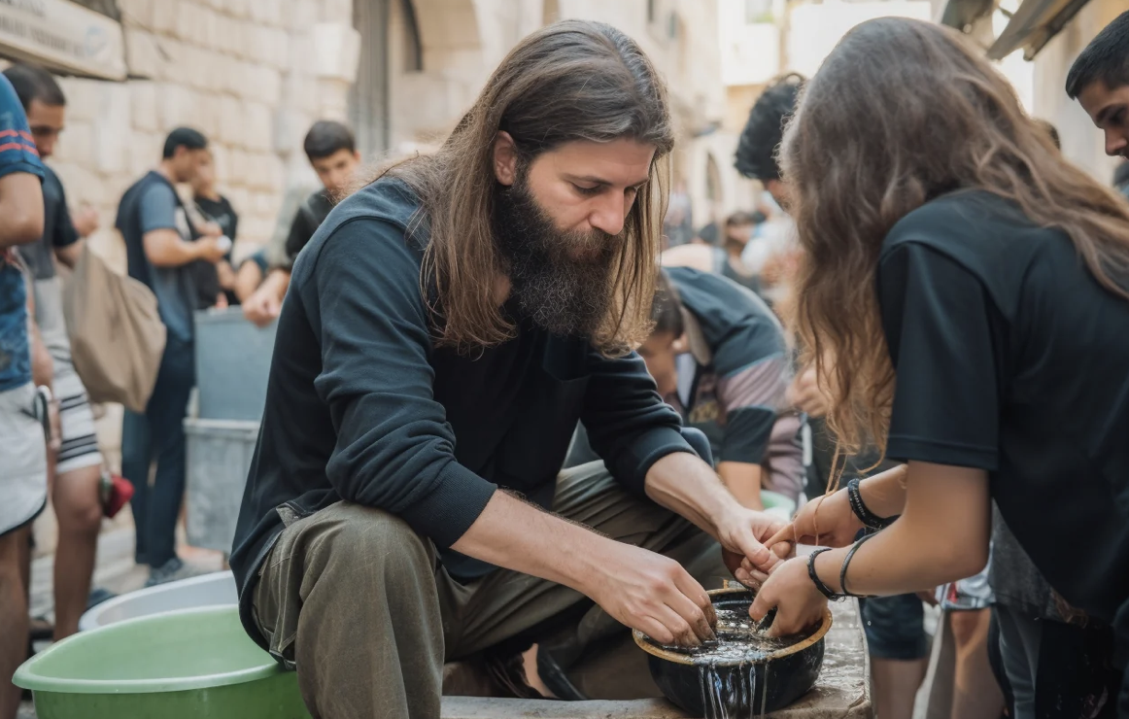
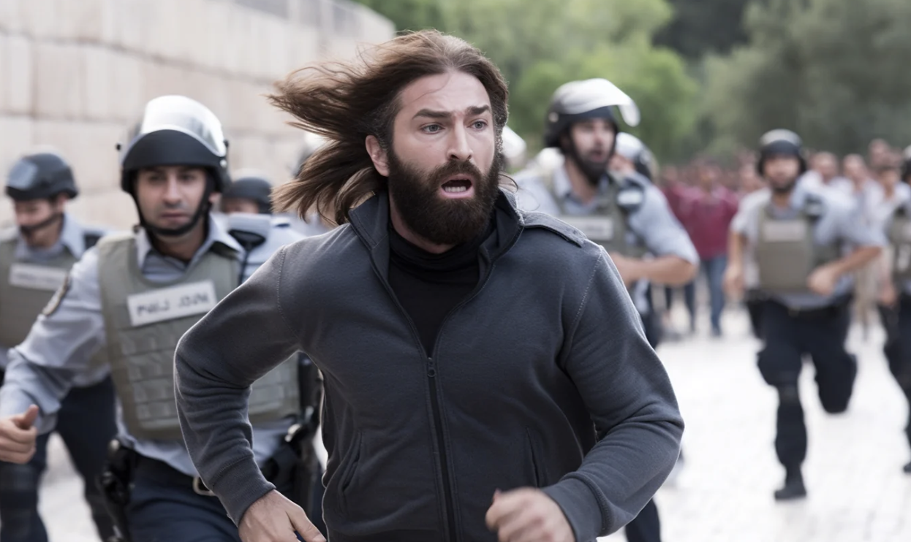
Word Made Flesh
Jesus and people in John’s Gospel
John’s Gospel is packed full of stories of Jesus meeting with individuals – intimately or with others observing. Some of these are lengthy encounters and some cover just a few short verses ,but in each, dialogue, place and time are precise and meaningful. These scenes are also shot through with John’s broader concerns and themes so that scholarship, theology and human observation are brought to life in vivid, multifaceted and energetic ways.
Stories covered in this series include the Samaritan woman, the man healed at the Pool of Bethesda, the woman accused of adultery, the man born blind, the raising of Lazarus, the anointing of Jesus by Mary, Gethsemane and Peter, and Pilate.
Other gospel writers’ stories are also prepared for this process.
Word Made Flesh is particularly influenced by the work of David Ford OBE, Regius Professor of Divinity Emeritus in the Cambridge University who has recently published a commentary on John’s Gospel published by Baker and is helping to shape this project.
Martin Young facilitates these performance workshops. He has been leading and planting churches for 30 years, engaging with local and global mission projects, and working with artists and musicians to shape fresh ways of expressing the gospel of the Kingdom of Heaven.
Word Made Flesh is also being developed as a televised concept in a series of films under the title, Dramatic Encounters with Jesus.

Slide 4
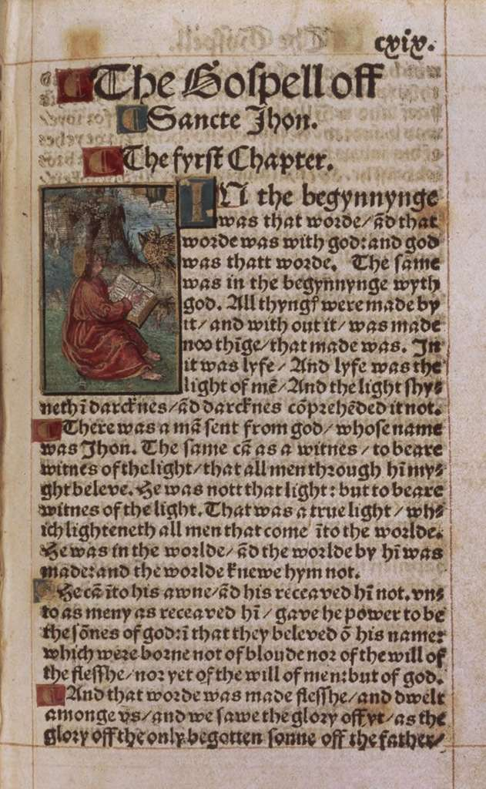
Word Made Flesh
The mechanics of the performance workshop
Ideally, at least 60 minutes is needed for a performance workshop.
This is typically preceded by an explanation and reasoning behind the process and followed by reflection and feedback.
This event is also done as a part of a worship service.
Actors can be brought in or identified from among the group and one or two preparation meetings held beforehand.
For some stories other artists may also be used, including musicians, painters, poets etc – once again brought in or invited from the among the group.
Suitable space is needed where the audience can all see the performance – using seating in the round and/or staging blocks. Depending on the space, there may need to be microphones for principals (usually just 2 or 3) and for instruments or accompanying music used.
For more information email martin@this-is-that.com +447715597039

